Slide 1
E-Commerce Product Recommendation System
SHASHAANK GUPTA (SG6661)
NAMAS MANKAD(NKM9348)
ANKIT SATI (AS14128)
AKSHAT JAIN (AJ3186)
KRINA BHIMANI (KB3687)

Slide 2
Problem Statement
Motivation
We have built a recommendation system for E-commerce Products. We have used 2 datasets: Product Reviews Dataset and Product Metadata Dataset.
Understanding price trends of various products.
Working on a very large chunk of data.
Comparing results from established tools.
Apply class learnings on a project.

Slide 3
Related Work
Artwork Personalization at Netflix:
Netflix also try to use sort of image features in building their state-of-the art recommendation engines.
Their hypothesis is that, if the movie poster and the artwork involved in the poster is not reflecting the title of the movie or a particular aspect of a culture, then it is highly unlikely that the movie will get expected number of views.
Authors in blog, have come up with a Scoring-Based Recommendation System for their movies.
Visually-Aware Recommender System for Amazon Products:
Image features are too important in deciding whether a user will like a product or not.
For instance, a user will not buy a t-shirt if there are no pictures, a user will buy a product if it is endorsed by a celebrity, etc.
Authors in papers, have tried to come up with a Visual-Aware Recommender System for this dataset.

Slide 4
Pipeline of our approach
Collection of Dataset
Data Understanding/Preparation
Data Integration & Reduction
Semantic Analysis of reviews
Data Analysis and Visualization
Modeling
Model Evaluation
Results, Reports and Learnings of this project
Shortcomings and Future scope

Slide 5
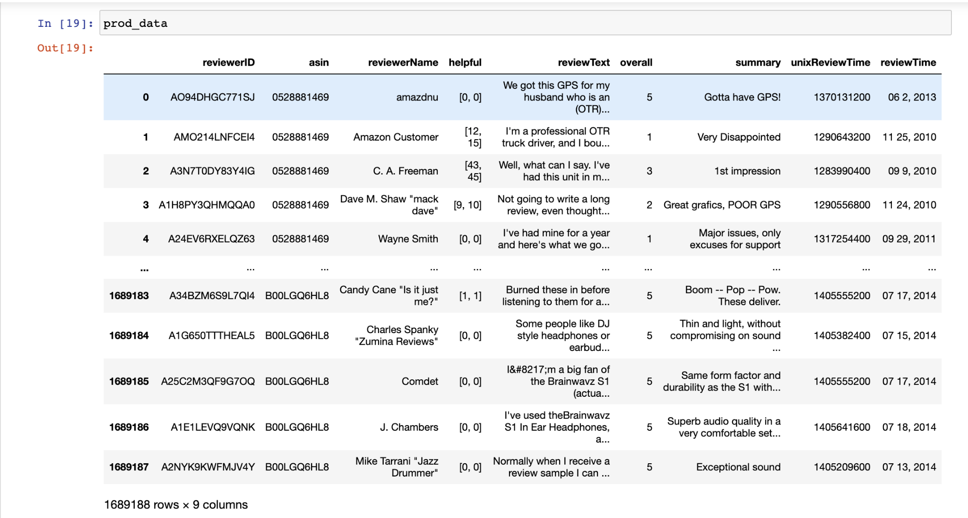
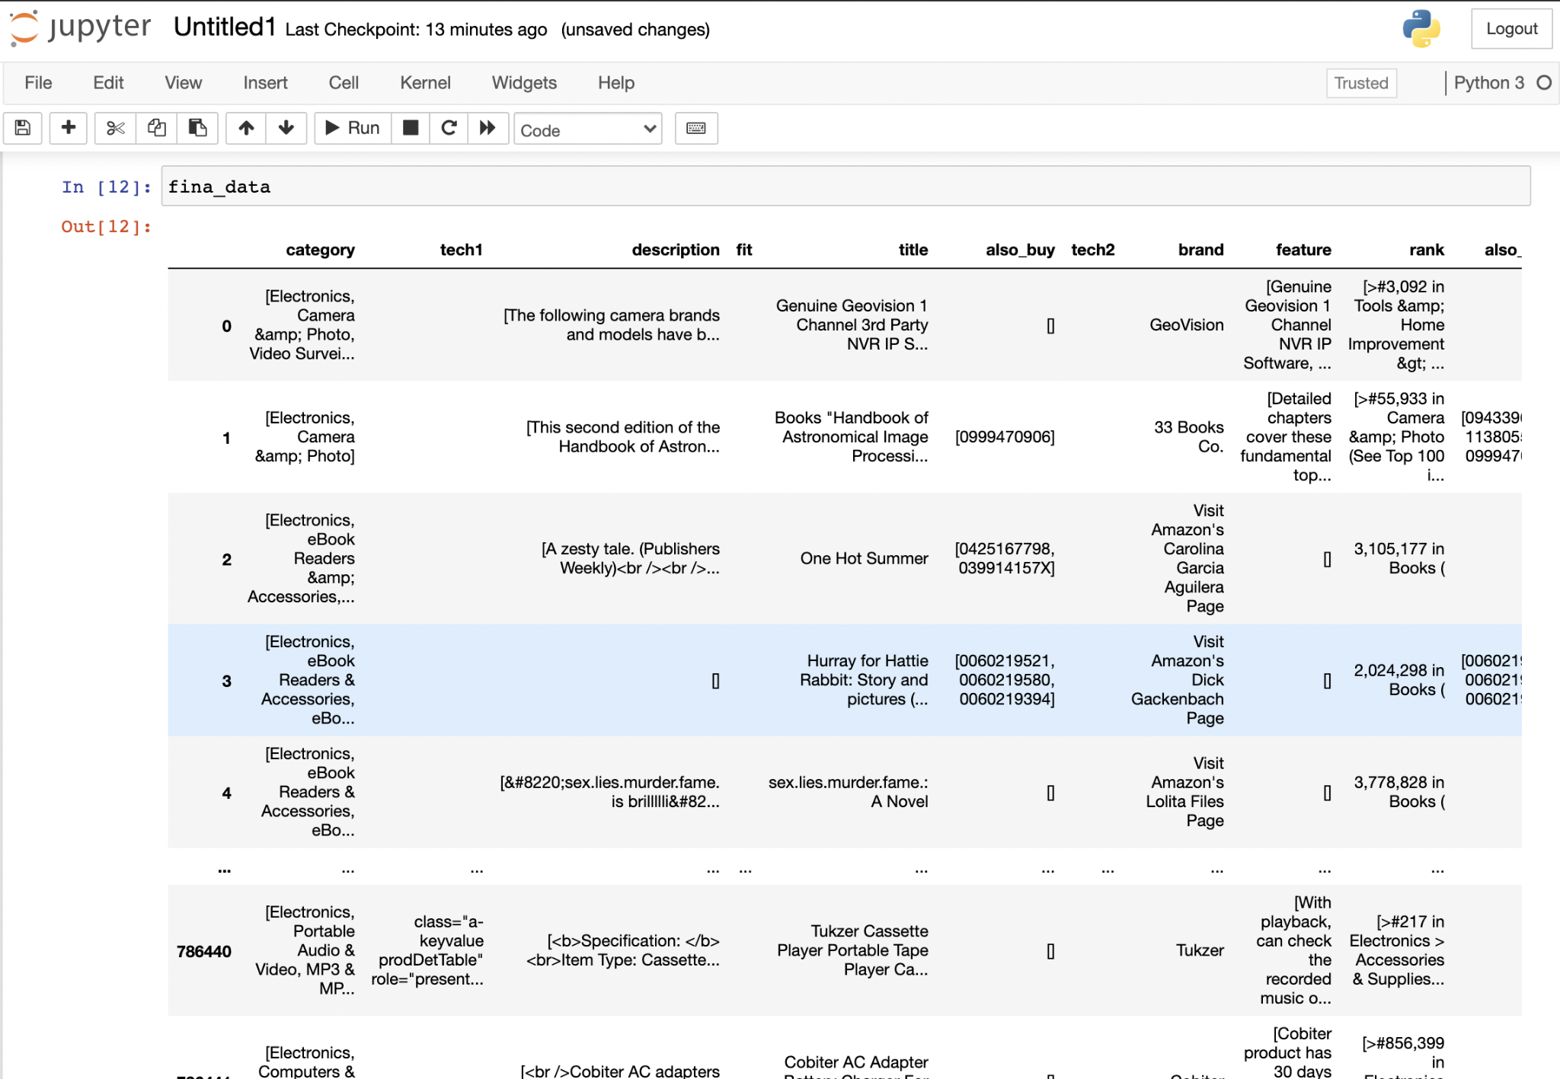
Collection of Dataset
Product Reviews Dataset (2 GB - json) (17 lac records) | Product Metadata Dataset (12GB - json) (8 lac instances)
http://snap.stanford.edu/data/amazon/productGraph/categoryFiles/reviews_Electronics_5.json.gz | http://deepyeti.ucsd.edu/jianmo/amazon/metaFiles/meta_Electronics.json.gz

Slide 6
Data Understanding/Preparation
Product Metadata Dataset contained details about the features of the product like product sub-category, products bought together, products viewed together, similar products, etc.
Product Reviews Dataset contained details about the ratings, reviews, and summary provided by the user’s who actually ended up buying that product.

Slide 7
Tools Used and Observations
Rapidminer | To modify Json file into a List of Json object. | Explored below extensions: Web Automation Extension Operator Toolbox Text Processing Could not find a relevant operator which could achieve our goal.
Eclipse - Java | To modify Json file into a List of Json object. | Eclipse Heap Space allocated 8 GB. Could only process 2GB Json file.
HPC Greene - Python | To modify Json file into a List of Json object. | 2-core GPU with 32GB internal memory. Could process 12GB Json file.

Slide 8
Data Integration and Reduction
We first tried importing data to MySQL, as it would be easier to integrate them with the data visualization tools like tableau or power bi.
We also tried to use Java, Pyspark and then finally were able to prepare the data by utilizing HPC greene’s resources.

Slide 9
Data Integration and Reduction(Continued)
Reducing the data by PCA and SVD.
Reducing the data by selecting customer who has more than 5 transactions.
Reducing the data by selecting the year of the reviews.

Slide 10
Semantic analysis of reviews
Rapid Miner:
Read original Json File using “Read Document” operator (Text Processing).
Split the string with ‘\n’ as delimiter using “Split Doc Into Collection” operator (Operator Toolbox).
Flatten the Json Collection into example set using “” operator (Text Processing).
Extract Sentiment with Vader model using “Extract Sentiment” operator (Operator Toolbox).

Slide 11
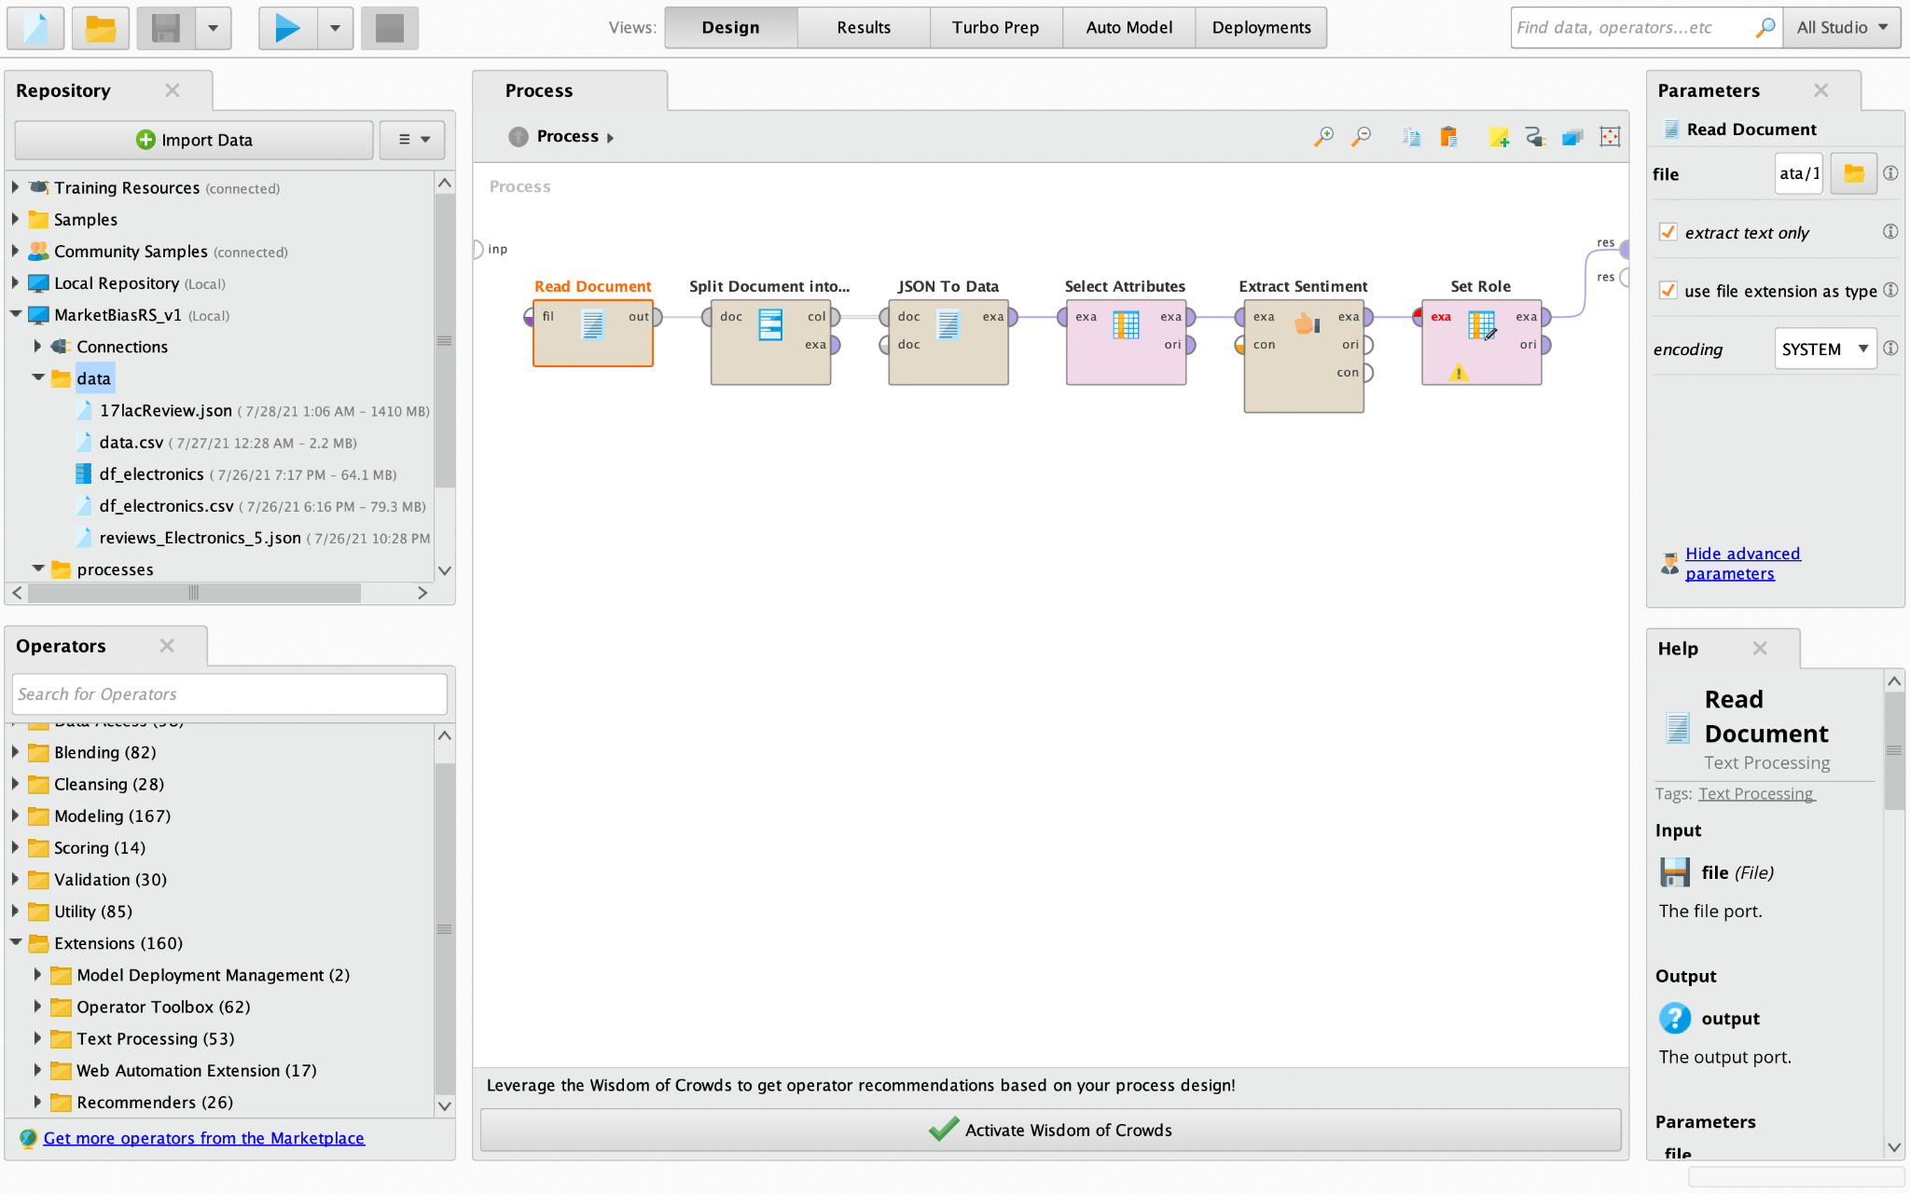
Overview of the process in Rapidminer

Slide 12
Semantic analysis of reviews (Continued)
2. Python approaches:
Bidirectional LSTM model ~ 94.7% accuracy (5 epochs, batch size = 50)
BERT pre-trained model ~ 98.3% accuracy (3 epochs, batch size = 32)

Slide 13
Proposed Algorithms
Demand based systems :- It operates by proposing high-rated products that have been seen and purchased by a large number of individuals. It isn't a recommendation tailored towards particular user.
Classification model based :- It works by analyzing the user's characteristics and using a classification algorithm to determine if the user is interested in the product or not.
Content based recommendations:- The primary premise is that if a user enjoys one item, he or she will enjoy "other" comparable items. It is based on information about the item's contents rather than user views.
Collaborative Filtering :- It is founded on the notion that people prefer things that are similar to other things they like, as well as items that other people with similar tastes like.
Hybrid Approaches :- Collaborative filtering, content-based filtering, and other methodologies are combined in this system approach.
Association rule mining :- The relationships between items are captured by association rules, which are based on their patterns of co-occurrence throughout transactions.

Slide 14
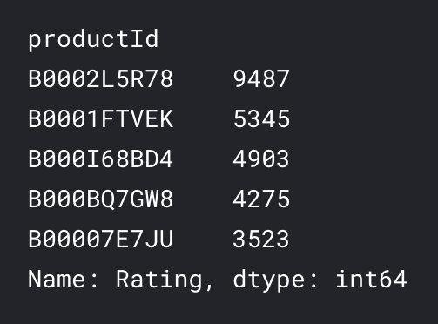
Modelling
Demand based systems - Suggesting the top 5 positively rated products (Frequency based)
Collaborative Filtering - Transposed the data matrix on product ids, used knn to find and suggest most similar products (features used - reviews, ratings, helpfulness, sub -categories )

Slide 15
Modelling
Content Based filtering : Converted every product into a feature matrix, and suggested the ones which are the nearest.
Association mining : After using the also_view, and also_bought features of the data. Divide the data into users, used “mlxtend” library in python to implement apriori and association rule mining based algorithm

Slide 16
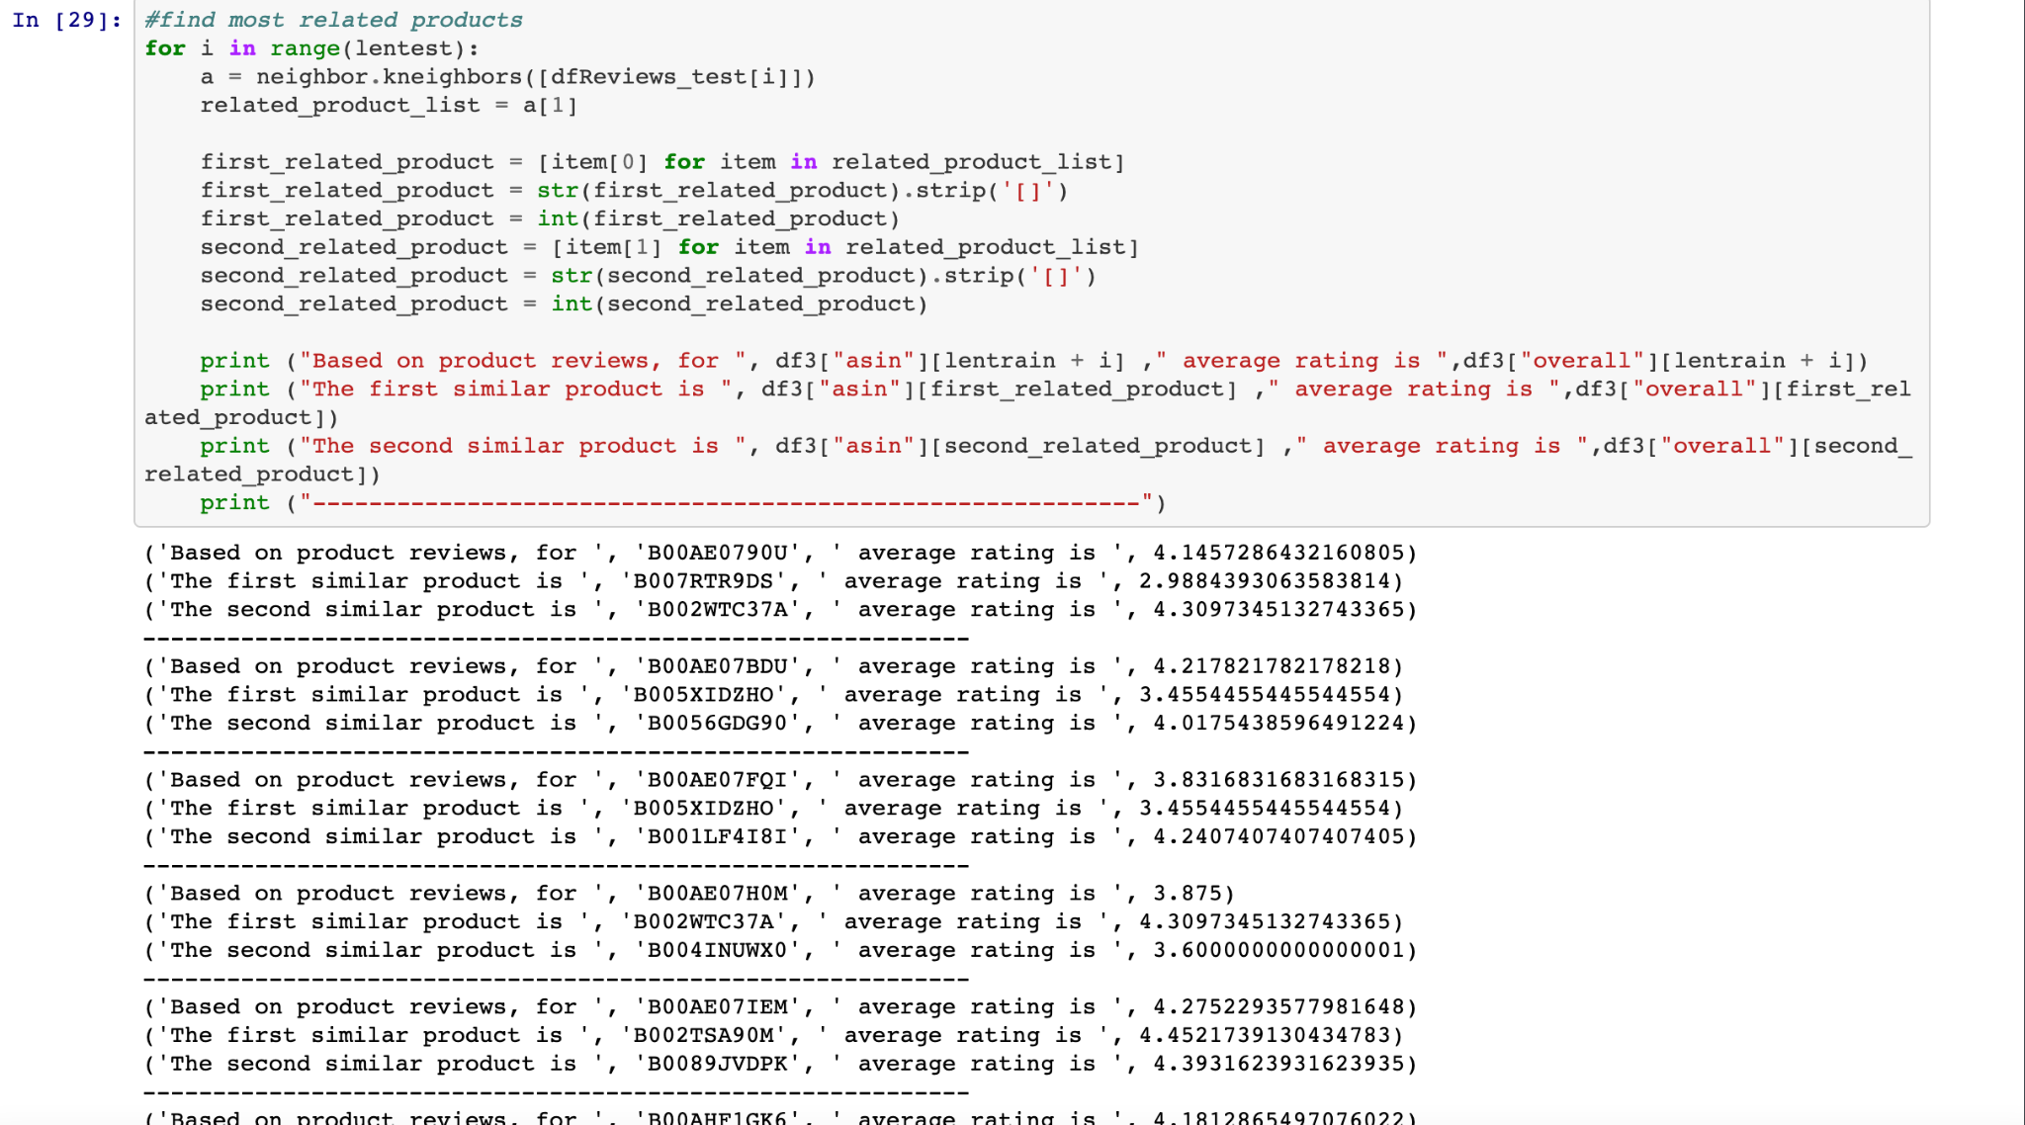
Results, Reports and Learnings of this Project
As the products that we had were mostly IDs, we tried to print the images from the url of the images that we had, but again all the products did not have the images.

Slide 17
References
https://towardsdatascience.com/sentiment-analysis-on-amazon-reviews-45cd169447ac
https://www.kaggle.com/ssismasterchief/knnbaseline-recommendation-systems-surprise
https://www.amazon.science/the-history-of-amazons-recommendation-algorithm
http://snap.stanford.edu/class/cs224w-2013/projects2013/cs224w-072-final.pdf
https://towardsdatascience.com/product-recommender-using-amazon-review-dataset-e69d479d81dd

Slide 18
Thank You

